Slide 1
This is a hidden slide
Dear honorable teacher please follow the instructions that has given in the slide notes (under the every slide). It would be helpful to take a successful class. Thanks a lot. I wish you good luck.

Slide 2
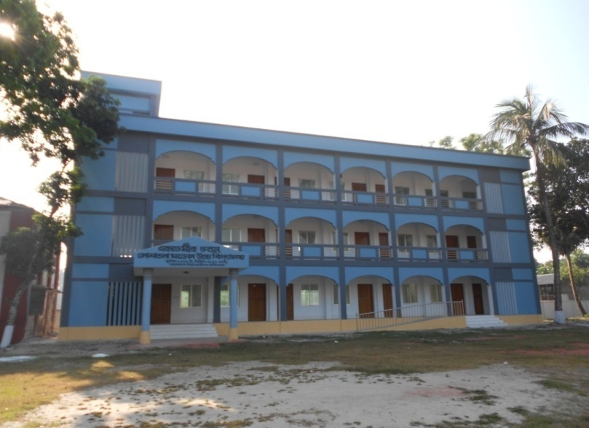
WELCOME
Notes:
Teacher can say it orally.

Slide 3
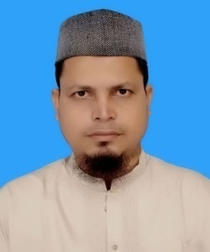
Identity
S.K.Md. Harunar Rashid
Assit: Teacher
Sonatola Model High School
Sonatola, Bogra.
Class Six
English For Today.
Notes:
Teacher can hide this slide.

Slide 4
Look at the picture and watch the video then guess where are they going?
Click here
Where are they going ?
They are going to school.
Notes:
At first teacher will try to elicit the answer form the SS, then he/she will give feedback by click.

Slide 5
Lesson Declaration
GOING T0 A NEW SCHOOL

Slide 6
Learning outcomes
After completing the lesson students will be able to ..
1.
read and understand texts
2.
Talk about people, places and familiar objects in short and simple sentences
3.
Write short paragraphs

Slide 7
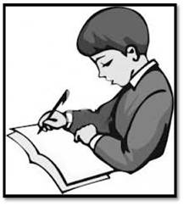
Go to section – A and try to know about Tarun.
Notes:
Teacher will help the students if needed.

Slide 8
Section – A1
Now write down similar information about yourself.
Notes:
Teacher can supply hard copy to write ss information. Otherwise they will use their note book.

Slide 9
Section – B. Read the following passage about tarun``s first day in the new school.
My ﬁrst day at the new school was interesting. I was going to school with my father in a rickshaw. We reached school after ﬁfteen minutes . My father said good bye and left me at the school gate. I went in and found that everyone had gone to class. I walked into my classroom and found a seat. After some time a teacher came and warmly greeted us. I found the students very friendly in my new class.
Notes:
Closing book ss will listen the teachers. Teacher can read the text orally or can play CD or audio file about this text that he/she collect before.

Slide 10
Read the following statement, write true or false beside the statements. Give correct information for the false statements.
1. Tarun`s first day at the new school was interesting.
True
Correct answer: Tarun went to his new school by rickshaw.
False
2. He went to his new school by school bus.
Correct answer : Tarun`s father left him at the school gate.
3. His mother left him at the school gate.
False
4. They reached school after fifteen minutes.
True
5. Tarun found the students very friendly in his new school.
True
Go
Ans:
1
2
3
4
5
Correct answer:
Notes:
After throwing the statements, teacher will try to elicit the answer from the student if they fail, teacher can give feedback by clicking ans: button 1, 2, 3, 4, 5. To know correct answer elicit on correct answer button.

Slide 11
Good bye
Key word
Tarun`s father said good-bye and left him at the school gate.
Meaning
(Click here)
farewell
Notes:
At first teacher will show the words then ask his/her students to tell the meaning and making sentences. If they fail teacher will show the picture again. For feedback click on meaning button.

Slide 12
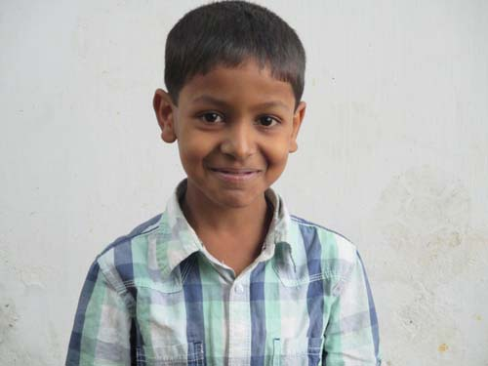
Interesting
Key word
My first day at the school was very interesting.
Meaning
(Click here)
Remarkable / exciting / enjoyable
Notes:
At first teacher will show the words then ask his/her students to tell the meaning and making sentences. If they fail teacher will show the picture again. For feedback click on meaning button.

Slide 13
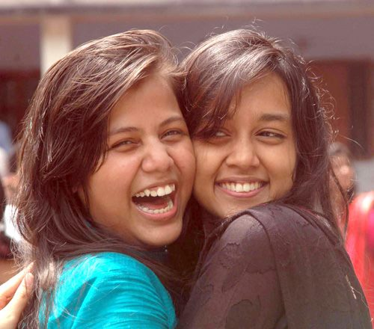
Warmly
Key word
My sister recived her friend warmly.
Meaning
(Click here)
Affectionately / cordially
Notes:
At first teacher will show the words then ask his/her students to tell the meaning and making sentences. If they fail teacher will show the picture again. For feedback click on meaning button.

Slide 14
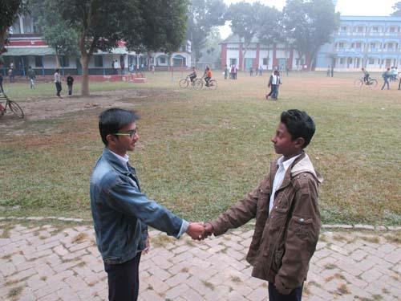
Greet
Key word
My friends also greeted me warmly.
Meaning
(Click here)
Welcome / receive
Notes:
At first teacher will show the words then ask his/her students to tell the meaning and making sentences. If they fail teacher will show the picture again. For feedback click on meaning button.

Slide 15
Individual work
Open your book read silently then match a word from Column - A with a word from column - B that has similar meaning.
Column - A | Column - B
difficult Stuck Traffic Direction | route complicated jammed travel
Notes:
Students can use blackboard or give answer orally. Then teacher can give feedback. After this teacher can go to section B2.

Slide 16
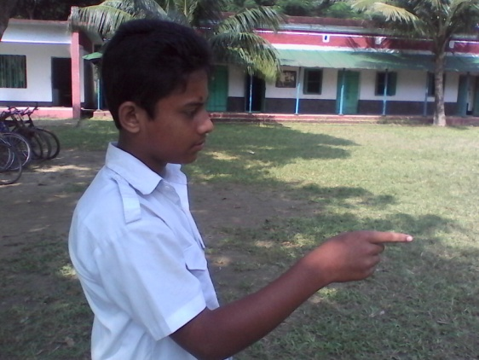
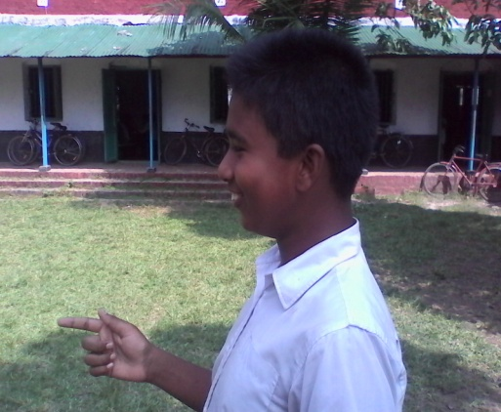
Group/Pair works
Follow the conversation and Talk with your friends about your first day in school and how you felt – happy, frightened, excited or embarrassed.
Sayeed : I went to school with my mother.
We got to the school by a rickshaw.
No, I was not late.
Dear Saad : At first day with whom did you go to school ?
My class teacher took me with him.
How did you feel that day ?
Thank you.
Were you late for the school ?
How did you reach your class ?
I was very happy and excited.
How did you get to the school ?
You are welcome.
Notes:
After showing the conversation teacher will call 2/3 pairs for practice.

Slide 17
HOME WORK
Write a paragraph about your first day at school within 5 sentences .
Notes:
Teacher can give some instructions to do the home work.

Slide 18
Acknowledgement
We would like to express our cordial gratitude to the Ministry of Education, Directorate of Secondary & Higher Education, NCTB, a2i
and
the panel of honorable editors ( Md. Jahangir Hasan, Associate Professor (English) TTC, Rangpur, Ranjit Poddar, Associate Professor (English) TTC, Dhaka, and Urmila Ahmed, Associate Professor (English) TTC, Dhaka, to enrich the contents.

Slide 19
THE END

